Slide 1
28-Homobrassinolide- CIPAC Small Scale Collaborative Study
CIPAC technical meeting 2020
Jason Zhang (Chinese Pesticide Advisory Committee, CHIPAC)
Method developed by Jiangxi Windeal Biotechnology Co., Ltd.

Slide 2
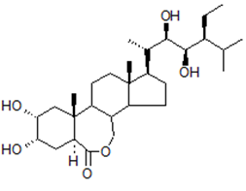
GENERAL INFORMATION
Common name | 28-Homobrassinolide
Chemical Name | (5S,6R)-10-((2S,3R,4R,5S)-5-ethyl-3,4-dihydroxy-6-methylheptan-2-yl)-5,6-dihydroxy-7a,9a-dimethyltetradecahydro-1H-benzo[c]indeno[5,4-e]oxepin-3(12bH)-one
Empirical formula | C₂₉H₅₀O₆
Structure
RMM | 494.8
m.p. | 256~257°C
Solubility (g/L, 20℃) | In water 5mg/l, acetonitrile 1.3g/l, ethanol 5.2g/l, methanol 2.7g/l at 20 °C.
Description | White powder
Stability | Stable in neutral and weak alkaline condition but hydrolysed in acidic conditions
Formulation | Emulsifiable concentrate, soluble liquid

Slide 3
PARTICIPANTS
Two technical samples, two SL samples and one EC sample were sent to the following 6 participants in February 2020.
By the end of April 2020, all 6 participants provided their results to CHIPAC.
Lab No. | Name of responsible person | Lab Name | Country
1 | Liu ShuZhen | Jiangxi Windeal Biotechnology Co., Ltd. - Quality Department | Jiangxi, China
2 | Sun Fengying | Kaifeng Yitian Biotechnology Co., Ltd. - quality control department | Henan, China
3 | Chen Mirror | GreenTech Laboratory Co., Ltd. | Shanghai, China
4 | Mei Quanfu | Jiangxi Buffett Chemical Co., Ltd. - quality control department | Jiangxi, China
5 | Chang Feng | Shandong Huihan Biotechnology Co., Ltd. - analysis room | Shandong, China
6 | Liu Xinsheng | Guangdong Zhongxun Agricultural Technology Co., Ltd. - PTD Center | Guangdong, China

Slide 4
28-Homobrassinolide- CIPAC SMALL SCALE COLLABORATIVE STUDY
Summary of the statistical evaluation no elimination of any outliers
 | TC-1 | TC-2 | SL-1 | SL-2 | EC
Xm | 955.7 | 950.7 | 0.041 | 0.042 | 0.100
L | 6 | 6 | 6 | 6 | 6
S_{r} | 1.862 | 2.535 | 0.00053 | 0.00098 | 0.00101
S_{R} | 2.422 | 6.516 | 0.00146 | 0.00229 | 0.00715
r | 5.214 | 7.098 | 0.00148 | 0.00274 | 0.00283
R | 6.782 | 18.245 | 0.00409 | 0.00641 | 0.02002
RSD_{r} | 0.195 | 0.267 | 1.296 | 2.342 | 1.017
RSD_{R} | 0.253 | 0.685 | 3.585 | 5.485 | 7.173
RSDR (Hor) | 2.014 | 2.015 | 9.160 | 9.123 | 8.004
HorRat Value | 0.126 | 0.340 | 0.391 | 0.601 | 0.896
Xm = average
L = number of laboratories
S_{r} = repeatability standard deviation
S_{R} = reproducibility standard deviation
RSD_{r} = repeatability relative standard deviation
RSD_{R} = reproducibility relative standard deviation
r = repeatability
R = reproducibility
RSD_{R} (Hor) = Horwitz value calculated from: 2^(1 - 0.5log c) where c = the concentration of the analyte as a decimal fraction

Slide 5
Summary of the statistical evaluation with elimination of stragglers
 | TC-1 | TC-2 | SL-1 | SL-2 | EC
Xm | 955.7 | 953.1 | 0.041 | 0.042 | 0.102
L | 6 | 5 | 6 | 6 | 5
S_{r} | 1.862 | 2.750 | 0.00053 | 0.00098 | 0.00109
S_{R} | 2.422 | 2.786 | 0.00146 | 0.00229 | 0.00121
r | 5.214 | 7.7 | 0.00148 | 0.00274 | 0.00305
R | 6.782 | 7.801 | 0.00409 | 0.00641 | 0.00339
RSD_{r} | 0.195 | 0.288 | 1.296 | 2.342 | 1.061
RSD_{R} | 0.253 | 0.292 | 3.585 | 5.485 | 1.179
RSDR (Hor) | 2.014 | 2.014 | 9.160 | 9.123 | 7.970
HorRat Value | 0.126 | 0.145 | 0.391 | 0.601 | 0.148
Xm = average
L = number of laboratories
S_{r} = repeatability standard deviation
S_{R} = reproducibility standard deviation
RSD_{r} = repeatability relative standard deviation
RSD_{R} = reproducibility relative standard deviation
r = repeatability
R = reproducibility
RSD_{R} (Hor) = Horwitz value calculated from: 2^(1 - 0.5log c) where c = the concentration of the analyte as a decimal fraction

Slide 6
Summary of the statistical evaluation with elimination of outliers
 | TC-1 | TC-2 | SL-1 | SL-2 | EC
Xm | 955.7 | 953.1 | 0.041 | 0.042 | 0.102
L | 6 | 5 | 5 | 6 | 5
S_{r} | 1.862 | 2.750 | 0.00058 | 0.00098 | 0.00109
S_{R} | 2.422 | 2.786 | 0.00072 | 0.00229 | 0.00121
r | 5.214 | 7.7 | 0.00162 | 0.00274 | 0.00305
R | 6.782 | 7.801 | 0.00202 | 0.00641 | 0.00339
RSD_{r} | 0.195 | 0.288 | 1.401 | 2.342 | 1.061
RSD_{R} | 0.253 | 0.292 | 1.738 | 5.485 | 1.179
RSDR (Hor) | 2.014 | 2.014 | 9.142 | 9.123 | 7.970
HorRat Value | 0.126 | 0.145 | 0.190 | 0.601 | 0.148
Xm = average
L = number of laboratories
S_{r} = repeatability standard deviation
S_{R} = reproducibility standard deviation
RSD_{r} = repeatability relative standard deviation
RSD_{R} = reproducibility relative standard deviation
r = repeatability
R = reproducibility
RSD_{R} (Hor) = Horwitz value calculated from: 2^(1 - 0.5log c) where c = the concentration of the analyte as a decimal fraction

Slide 7
Analytical Method
Outline of Method
The 28-Homobrassinolide content of the samples is determined by high performance liquid chromatography on ODS-C18 film stainless column with UV detector at 220 nm, quantified by external standard method.
Column: | 250mm x 4.6 mm (id), packed with ODS-C18, or equivalent | Eluent: | acetonitrile+ water = 80 + 20（v/v）
Column Temperature: | 25℃ | Flow Rate: | 1.0 ml/min
Detector Wavelength： | 220nm | Injection Volume: | 10μL
Retention time: | Approximately 20.5min

Slide 8
Analytical Method
Preparation of the test substance solution and determination
Preparation of standard solution: prepare standard solution in duplicate. Weigh 0.015g (to the nearest 0.1mg) 28-Homobrassinolide standard into 25ml volumetric flask, dissolved by 10ml methanol. Add 10ml phenylboronic acid solution, react 30min in calorstat at 50°C. Allow the solution to cool to ambient temperature and fill to the mark with methanol. Mix thoroughly and place the flask in an ultrasonic bath for 5 min, then filter the solution through a 0.45μm filter membrane prior to analysis.
Preparation of sample solution: prepare sample solution in duplicate. Weigh 0.015g (to the nearest 0.1mg) sufficient sample to contain about 15mg 28-Homobrassinolide into 25ml volumetric flask, dissolved by 10ml methanol. Add 10ml phenylboronic acid solution, react 30min in calorstat at 50°C. Allow the solution to cool to ambient temperature and fill to the mark with methanol. Mix thoroughly and place the flask in an ultrasonic bath for 5 min, then filter the solution through a 0.45μm filter membrane prior to analysis. (Sample solutions S1 and S2).
Determination: Inject in duplicate 10μL portions of each sample solution bracketing them by injections of the calibration solutions as follows: C_{A}, S₁, S₁, C_{B}, S₂, S₂, C_{A}, etc.

Slide 9
Study format
Samples
28-Homobrassinolide Technical (SAMPLE A)
28-Homobrassinolide Technical (SAMPLE B)
28-Homobrassinolide Soluble Liquid (SAMPLE C)
28-Homobrassinolide Soluble Liquid (SAMPLE D)
28-Homobrassinolide Emulsifiable Concentrate (SAMPLE E)
Protocol
The samples were analyzed on two different days with duplicate injections weighting per sample. Test and calibration solutions were prepared fresh on each day. The sample content was calculated using the mean value of the duplicate injections.

Slide 10
Analytical conditions
Lab Number | Analytical Conditions
Laboratory 1 | Column: SHIMADZU, 4.6mm×250mm, 8FR98171 Remarks: None
Laboratory 2 | Column: Elite, 4.6mm×250mm, E2616571 Remarks: None
Laboratory 3 | Column: Shimadzu InerStainTM C18, 250mm×4.6mm, 5μm Remarks: None
Laboratory 4 | Column: Agilent, 4.6mm×250mm, USNH075205 Remarks: None
Laboratory 5 | Column: Agilent, TC-C18(2), 250mm×4.6mm Remarks: Column temperature is 35℃, Injection volume is 5µL.
Laboratory 6 | Column: XTERRA MS C18, 4.6mm×250mm, 03273926014075 Remarks: None

Slide 11
DATA Evaluation and Discussion
ORINGINAL DATA (g/kg)
 | 28-Homobrassinolide SAMPLE A |  |  |  | 28-Homobrassinolide SAMPLE B |  |  |  | 28-Homobrassinolide SAMPLE C
 | Day1 |  | Day2 |  | Day1 |  | Day2 |  | Day1
Laboratory 1 | 959.5 | 957.7 | 955.1 | 956.1 | 951.6 | 952.3 | 951.0 | 952.9 | 0.041 | 0.041
Laboratory 2 | 959.7 | 957.1 | 958.7 | 954.6 | 950.5 | 950.8 | 953.4 | 959.2 | 0.040 | 0.042
Laboratory 3 | 953.1 | 956.4 | 953.5 | 954.8 | 937.8 | 939.7 | 938.4 | 937.9 | 0.038 | 0.038
Laboratory 4 | 954.6 | 960.5 | 954.2 | 957.9 | 954.6 | 951.6 | 952.8 | 952.1 | 0.042 | 0.042
Laboratory 5 | 952.0 | 952.0 | 953.2 | 954.1 | 957.9 | 956.5 | 952.1 | 955.4 | 0.040 | 0.041
Laboratory 6 | 955.6 | 956.1 | 955.7 | 955.7 | 953.2 | 948.8 | 949.5 | 956.6 | 0.042 | 0.042

Slide 12
 | 28-Homobrassinolide SAMPLE C |  | 28-Homobrassinolide SAMPLE D |  |  |  | 28-Homobrassinolide SAMPLE E
 | Day2 |  | Day1 |  | Day2 |  | Day1 |  | Day2
Laboratory 1 | 0.041 | 0.041 | 0.042 | 0.042 | 0.042 | 0.042 | 0.101 | 0.101 | 0.103 | 0.101
Laboratory 2 | 0.041 | 0.040 | 0.046 | 0.047 | 0.044 | 0.042 | 0.104 | 0.105 | 0.101 | 0.102
Laboratory 3 | 0.038 | 0.038 | 0.038 | 0.039 | 0.038 | 0.038 | 0.085 | 0.085 | 0.086 | 0.0854
Laboratory 4 | 0.041 | 0.042 | 0.043 | 0.042 | 0.042 | 0.043 | 0.103 | 0.101 | 0.103 | 0.102
Laboratory 5 | 0.041 | 0.041 | 0.041 | 0.041 | 0.041 | 0.041 | 0.103 | 0.104 | 0.104 | 0.103
Laboratory 6 | 0.042 | 0.041 | 0.042 | 0.042 | 0.043 | 0.042 | 0.103 | 0.102 | 0.103 | 0.102

Slide 13
DATA EVALUATION AND DISCUSSION
MEAN VALUES (g/kg)
 | 28-Homobrassinolide SAMPLE A | 28-Homobrassinolide SAMPLE B | 28-Homobrassinolide SAMPLE C | 28-Homobrassinolide SAMPLE D | 28-Homobrassinolide SAMPLE E
Laboratory 1 | 957.1 | 952.0 | 0.041 | 0.042 | 0.102
Laboratory 2 | 957.5 | 953.5 | 0.041 | 0.045 | 0.103
Laboratory 3 | 954.5 | 938.5^{+/++} | 0.038⁺ | 0.038 | 0.086^{+/++}
Laboratory 4 | 956.9 | 952.8 | 0.042 | 0.042 | 0.102
Laboratory 5 | 952.9 | 955.5 | 0.041 | 0.041 | 0.104
Laboratory 6 | 955.8 | 952.0 | 0.041 | 0.042 | 0.102
⁺ Gubbs Test straggler
⁺⁺ Gubbs Test outlier

Slide 14
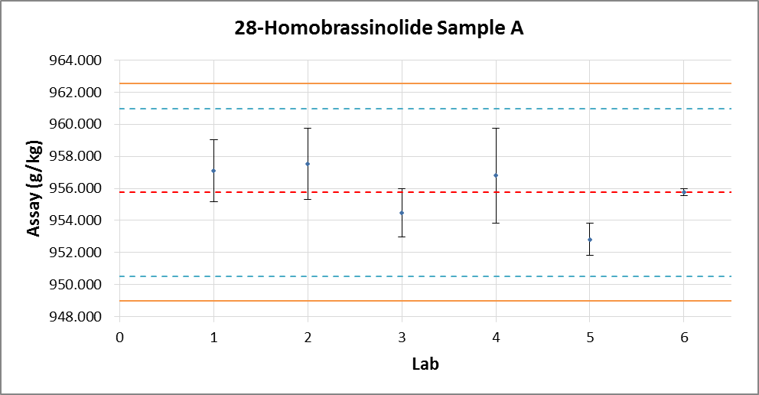
DATA Evaluation and Discussion
Xm | 955.7
L | 6
Sr | 1.862
S_{R} | 2.422
r | 5.214
R | 6.782
RSDr | 0.195
RSDR | 0.253
RSDR(Hor) | 2.014
HorRat | 0.126
Fig. 1 – 28-Homobrassinolide Sample A with outliers /stragglers

Slide 15
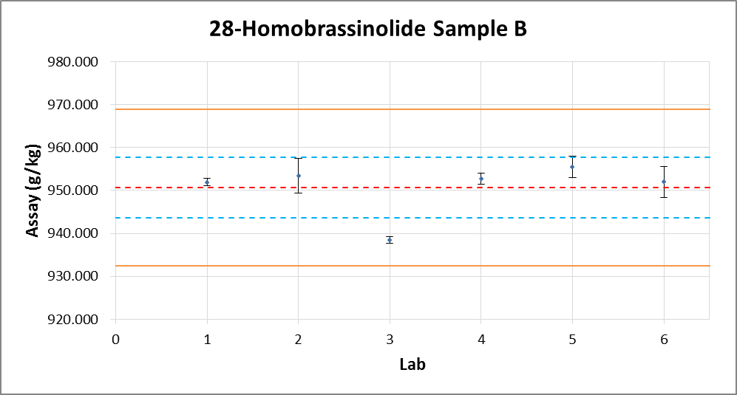
Xm | 950.7
L | 6
Sr | 2.535
S_{R} | 6.516
r | 7.098
R | 18.245
RSDr | 0.267
RSD_{R} | 0.685
RSD_{R}(Hor) | 2.015
HorRat | 0.340
Fig. 2 – 28-Homobrassinolide Sample B with outliers /stragglers

Slide 16
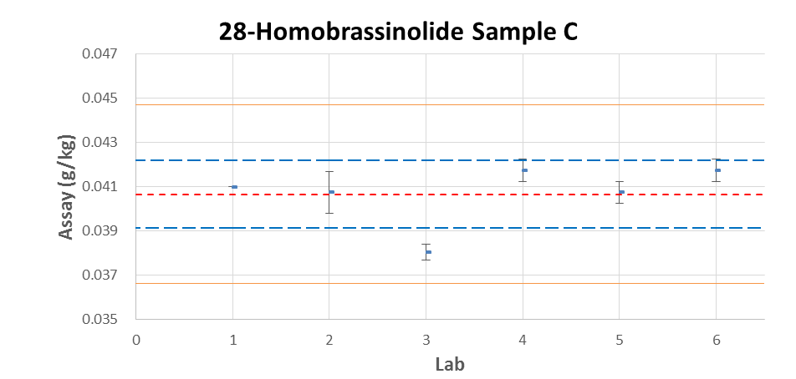
Xm | 0.041
L | 6
Sr | 0.00053
S_{R} | 0.00146
r | 0.00148
R | 0.00409
RSDr | 1.296
RSD_{R} | 3.585
RSD_{R}(Hor) | 9.160
HorRat | 0.391
Fig. 3 – 28-Homobrassinolide Sample C with outliers /stragglers

Slide 17
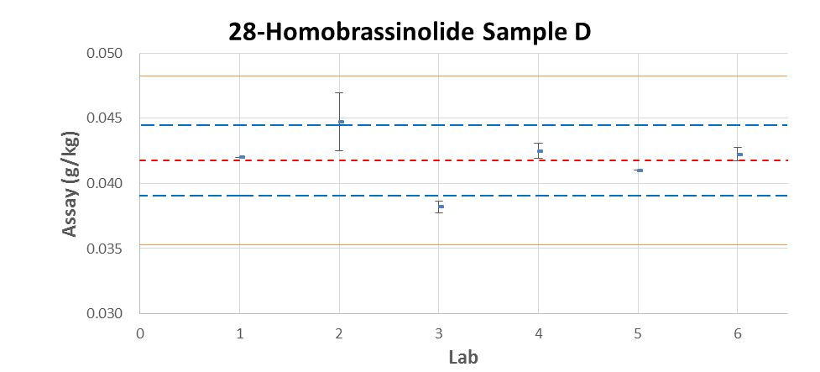
Xm | 0.042
L | 6
Sr | 0.00098
S_{R} | 0.00229
r | 0.00274
R | 0.00641
RSDr | 2.342
RSD_{R} | 5.485
RSD_{R}(Hor) | 9.123
HorRat | 0.601
Fig. 4 – 28-Homobrassinolide Sample D with outliers /stragglers

Slide 18
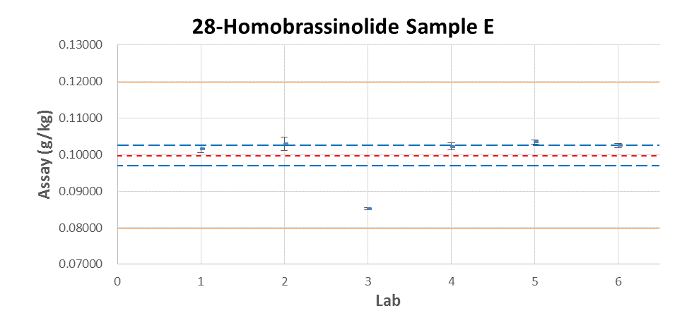
Xm | 0.100
L | 6
Sr | 0.00101
S_{R} | 0.00715
r | 0.00283
R | 0.02002
RSDr | 1.017
RSD_{R} | 7.173
RSD_{R}(Hor) | 8.004
HorRat | 0.896
Fig. 5 – 28-Homobrassinolide Sample E with outliers /stragglers

Slide 19
Summary
Summary of the statistical evaluation with outliers /stragglers
 | sample A | sample B | sample C | sample D | sample E
Xm | 955.7 | 950.7 | 0.041 | 0.042 | 0.100
L | 6 | 6 | 6 | 6 | 6
Sr | 1.862 | 2.535 | 0.00053 | 0.00098 | 0.00101
S_{R} | 2.422 | 6.516 | 0.00146 | 0.00229 | 0.00715
r | 5.214 | 7.098 | 0.00148 | 0.00274 | 0.00283
R | 6.782 | 18.245 | 0.00409 | 0.00641 | 0.02002
RSDr | 0.195 | 0.267 | 1.296 | 2.342 | 1.017
RSD_{R} | 0.253 | 0.685 | 3.585 | 5.485 | 7.173
RSD_{R}(Hor) | 2.014 | 2.015 | 9.160 | 9.123 | 8.004
HorRat | 0.126 | 0.340 | 0.391 | 0.601 | 0.896
Xm = average
L = number of laboratories
S_{r} = repeatability standard deviation
S_{R} = reproducibility standard deviation
RSD_{r} = repeatability relative standard deviation
RSD_{R} = reproducibility relative standard deviation
r = repeatability
R = reproducibility
RSD_{R} (Hor) = Horwitz value calculated from: 2^(1 - 0.5log c) where c = the concentration of the analyte as a decimal fraction

Slide 20
Summary of the statistical evaluation without stragglers
 | sample A | sample B | sample C | sample D | sample E
Xm | 955.7 | 953.1 | 0.041 | 0.042 | 0.102
L | 6 | 5 | 6 | 6 | 5
Sr | 1.862 | 2.750 | 0.00053 | 0.00098 | 0.00109
S_{R} | 2.422 | 2.786 | 0.00146 | 0.00229 | 0.00121
r | 5.214 | 7.7 | 0.00148 | 0.00274 | 0.00305
R | 6.782 | 7.801 | 0.00409 | 0.00641 | 0.00339
RSDr | 0.195 | 0.288 | 1.296 | 2.342 | 1.061
RSD_{R} | 0.253 | 0.292 | 3.585 | 5.485 | 1.179
RSD_{R}(Hor) | 2.014 | 2.014 | 9.160 | 9.123 | 7.970
HorRat | 0.126 | 0.145 | 0.391 | 0.601 | 0.148
Xm = average
L = number of laboratories
S_{r} = repeatability standard deviation
S_{R} = reproducibility standard deviation
RSD_{r} = repeatability relative standard deviation
RSD_{R} = reproducibility relative standard deviation
r = repeatability
R = reproducibility
RSD_{R} (Hor) = Horwitz value calculated from: 2^(1 - 0.5log c) where c = the concentration of the analyte as a decimal fraction
Sample B Results of Lab 3 eliminated, Sample E Results of Lab 3 eliminated.

Slide 21
Summary of the statistical evaluation without outliers
 | sample A | sample B | sample C | sample D | sample E
Xm | 955.7 | 953.1 | 0.041 | 0.042 | 0.102
L | 6 | 5 | 5 | 6 | 5
Sr | 1.862 | 2.750 | 0.00058 | 0.00098 | 0.00109
S_{R} | 2.422 | 2.786 | 0.00072 | 0.00229 | 0.00121
r | 5.214 | 7.7 | 0.00162 | 0.00274 | 0.00305
R | 6.782 | 7.801 | 0.00202 | 0.00641 | 0.00339
RSDr | 0.195 | 0.288 | 1.401 | 2.342 | 1.061
RSD_{R} | 0.253 | 0.292 | 1.738 | 5.485 | 1.179
RSD_{R}(Hor) | 2.014 | 2.014 | 9.142 | 9.123 | 7.970
HorRat | 0.126 | 0.145 | 0.190 | 0.601 | 0.148
Xm = average
L = number of laboratories
S_{r} = repeatability standard deviation
S_{R} = reproducibility standard deviation
RSD_{r} = repeatability relative standard deviation
RSD_{R} = reproducibility relative standard deviation
r = repeatability
R = reproducibility
RSD_{R} (Hor) = Horwitz value calculated from: 2^(1 - 0.5log c) where c = the concentration of the analyte as a decimal fraction
Sample B Results of Lab 3 eliminated, Sample C Results of Lab 3 eliminated, Sample E Results of Lab 3 eliminated.

Slide 22
conclusions
For all samples, the values of RSD_{R} (reproducibility relative standard deviation) were less than Horwitz’s value. As a reference, all HorRat values were not greater than 1.0. The proposed method is considered to be appropriate for the determination of 28-Homobrassinolide in technical material, SL and EC formulation.
CHIPAC proposes to proceed with a large scale collaborative study.

Slide 23
Thanks for your attention!

